Slide 1

Chapter 1: Introduction to Project Management
Information Technology Project Management, Seventh Edition
Tôn Long Phước– SE
tonlongphuoc@iuh.edu.vn
https://lms.iuh.edu.vn
.

Slide 2
Learning Objectives
Understand the growing need for better project management, especially for information technology (IT) projects
Explain what a project is, provide examples of IT projects, list various attributes of projects, and describe the triple constraint of project management
Describe project management and discuss key elements of the project management framework, including project stakeholders, the project management knowledge areas, common tools and techniques, and project success

Slide 3
Learning Objectives
Discuss the relationship between project, program, and portfolio management and the contributions each makes to enterprise success
Understand the role of project managers by describing what they do, what skills they need, and career opportunities for IT project managers
Describe the project management profession, including its history, the role of professional organizations like the Project Management Institute (PMI), the importance of certification and ethics, and the advancement of project management software
Notes:
portfolio : danh mục đầu tư

Slide 4
Introduction
Many organizations today have a new or renewed interest in project management
Computer hardware, software, networks, and the use of interdisciplinary and global work teams have radically changed the work environment
The world as a whole spends nearly $10 trillion of its $40.7 trillion gross product on projects of all kinds
More than 16 million people regard project management as their profession

Slide 5
Advantages of Using Formal Project Management
Better control of financial, physical, and human resources
Improved customer relations
Shorter development times
Lower costs
Higher quality and increased reliability
Higher profit margins
Improved productivity
Better internal coordination
Higher worker morale

Slide 6
What Is a Project?
A project is “a temporary endeavor undertaken to create a unique product, service, or result” (PMBOK® Guide, Fifth Edition, 2012)
Projects end when their objectives have been reached or the project has been terminated
Projects can be large or small and take a short or long time to complete
Notes:
temporary endeavor undertaken : một nỗ lực tạm thời

Slide 7
Examples of IT Projects
A team of students creates a smartphone application and sells it online
A company develops a driverless car
A small software development team adds a new feature to an internal software application for the finance department
A college upgrades its technology infrastructure to provide wireless Internet access across the whole campus

Slide 8
Project Attributes
A project
has a unique purpose
is temporary
is developed using progressive elaboration
requires resources, often from various areas
should have a primary customer or sponsor
The project sponsor usually provides the direction and funding for the project
involves uncertainty

Slide 9
Project and Program Managers
Project managers work with project sponsors, project team, and other people involved in a project to meet project goals
Program: group of related projects managed in a coordinated way to obtain benefits and control not available from managing them individually (PMBOK® Guide, Fifth Edition, 2012)
Program managers oversee programs; often act as bosses for project managers

Slide 10
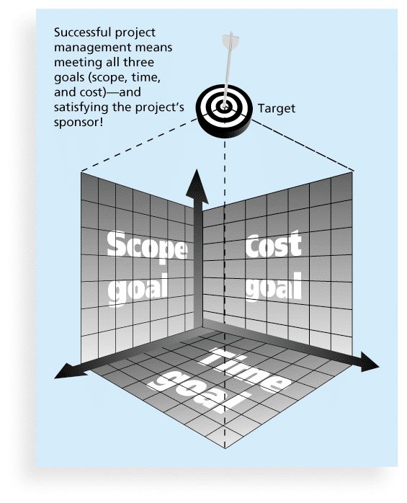
Figure 1-1 The Triple Constraint of Project Management

Slide 11
What is Project Management?
Project management is “the application of knowledge, skills, tools and techniques to project activities to meet project requirements” (PMBOK® Guide, Fourth Edition, 2012)
Project managers strive to meet the triple constraint (project scope, time, and cost goals) and also facilitate the entire process to meet the needs and expectations of project stakeholders

Slide 12
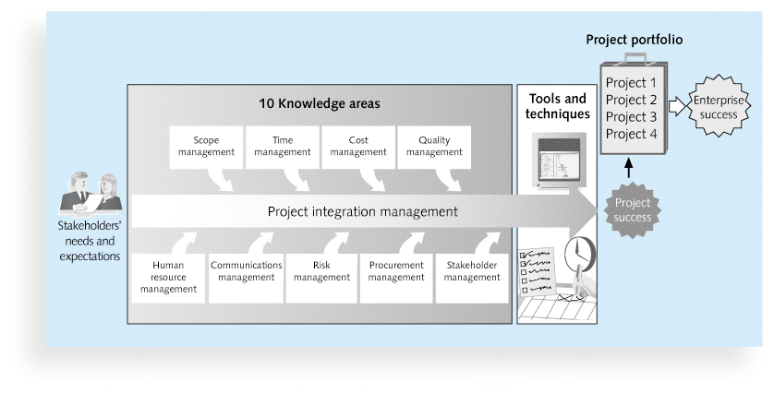
Figure 1-2 Project Management Framework

Slide 13
Project Stakeholders
Stakeholders are the people involved in or affected by project activities
Stakeholders include
the project sponsor
the project manager
the project team
support staff
customers
users
suppliers
opponents to the project

Slide 14
Project Management Tools and Techniques
Project management tools and techniques assist project managers and their teams in various aspects of project management
Some specific ones include
Project charter, scope statement, and WBS (scope)
Gantt charts, network diagrams, critical path analysis, critical chain scheduling (time)
Cost estimates and earned value management (cost)
See Table 1-1 for many more

Slide 15
Super Tools
“Super tools” are those tools that have high use and high potential for improving project success, such as:
Software for task scheduling (such as project management software)
Scope statements
Requirements analyses
Lessons-learned reports
Tools already extensively used that have been found to improve project importance include:
Progress reports
Kick-off meetings
Gantt charts
Change requests

Slide 16
What Went Right? Improved Project Performance
The Standish Group’s CHAOS studies show improvements in IT projects in the past decade:
The number of successful IT projects has more than doubled, from 16 percent in 1994 to 37 percent in 2010
The number of failed projects decreased from 31 percent in 1994 to 21 percent in 2010
Success rates were the highest ever in the most recent CHAOS study

Slide 17
Why the Improvements?
"The reasons for the increase in successful projects vary. First, the average cost of a project has been more than cut in half. Better tools have been created to monitor and control progress and better skilled project managers with better management processes are being used. The fact that there are processes is significant in itself.”*
*Standish Group, "CHAOS 2001: A Recipe for Success" (2001).

Slide 18
Project Success
There are several ways to define project success:
The project met scope, time, and cost goals
The project satisfied the customer/sponsor
The results of the project met its main objective, such as making or saving a certain amount of money, providing a good return on investment, or simply making the sponsors happy

Slide 19
Table 1-2: What Helps Projects Succeed?*
1. User involvement
2. Executive support
3. Clear business objectives
4. Emotional maturity
5. Optimizing scope
6. Agile process
7. Project management expertise
8. Skilled resources
9. Execution
10. Tools and infrastructure
*The Standish Group, “CHAOS Activity News” (August 2011).

Slide 20
The Role of the Project Manager
Job descriptions vary, but most include responsibilities like planning, scheduling, coordinating, and working with people to achieve project goals
Remember that 97% of successful projects were led by experienced project managers, who can often help influence success factors

Slide 21
Suggested Skills for Project Managers
The Project Management Body of Knowledge
Application area knowledge, standards, and regulations
Project environment knowledge
General management knowledge and skills
Soft skills or human relations skills

Slide 22
Table 1-3 Ten Most Important Skills and Competencies for Project Managers
1. People skills
2. Leadership
3. Listening
4. Integrity, ethical behavior, consistent
5. Strong at building trust
6. Verbal communication
7. Strong at building teams
8. Conflict resolution, conflict management
9. Critical thinking, problem solving
10. Understands, balances priorities
Notes:
Integrity: chính trực

Slide 23
Different Skills Needed in Different Situations
Large projects: Leadership, relevant prior experience, planning, people skills, verbal communication, and team-building skills were most important
High uncertainty projects: Risk management, expectation management, leadership, people skills, and planning skills were most important
Very novel projects: Leadership, people skills, having vision and goals, self confidence, expectations management, and listening skills were most important
Notes:
Các dự án không chắc chắn cao
Các dự án rất mới lạ

Slide 24
Importance of Leadership Skills
Effective project managers provide leadership by example
A leader focuses on long-term goals and big-picture objectives while inspiring people to reach those goals
A manager deals with the day-to-day details of meeting specific goals
Project managers often take on the role of both leader and manager

Slide 25
Careers for IT Project Managers
In a 2011 survey, IT executives listed the “nine hottest skills” they planned to hire for in 2012
Project management was second only to programming and application development

Slide 26
Table 1-4. Nine Hottest Skills*
Skill |  | Percentage of Respondents
Programming and application development |  |  | 60%
Project management |  |  | 44%
Help desk/technical support |  |  | 35%
Networking |  |  | 35%
Business intelligence |  |  | 23%
Data center |  |  | 18%
Web 2.0 |  |  | 18%
Security |  |  | 17%
Telecommunications |  |  | 9%
*Source: Rick Saia, “9 Hot IT Skills for 2012,”
Computerworld, September 26, 2011.

Slide 27
The Project Management Profession
The profession of project management is growing at a very rapid pace
It is helpful to understand the history of the field, the role of professional societies like the Project Management Institute, and the growth in project management software

Slide 28
The Project Management Institute
The Project Management Institute (PMI) is an international professional society for project managers founded in 1969
PMI has continued to attract and retain members, reporting more than 380,000 members worldwide by 2012
There are communities of practices in many areas, like information systems, financial services, and health care
Project management research and certification programs continue to grow
Students can join PMI at a reduced fee and earn the Certified Associate in Project Management (CAPM) certification(see www.pmi.org for details)

Slide 29
Project Management Certification
PMI provides certification as a Project Management Professional (PMP)
A PMP has documented sufficient project experience, agreed to follow a code of ethics, and passed the PMP exam
The number of people earning PMP certification is increasing quickly
PMI and other organizations offer additional certification programs (see Appendix B)

Slide 30
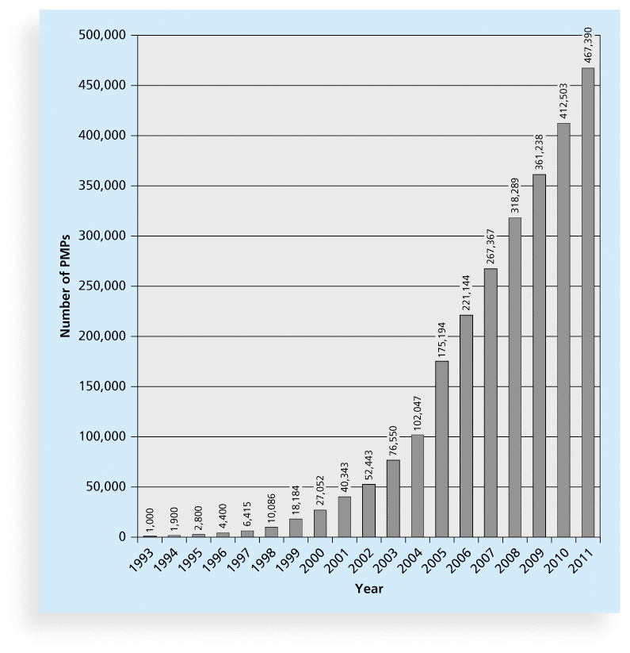
Figure 1-9 Growth in PMP Certification, 1993-2011

Slide 31
Chapter Summary
A project is a temporary endeavor undertaken to create a unique product, service, or result
Project management is the application of knowledge, skills, tools, and techniques to project activities to meet project requirements
A program is a group of related projects managed in a coordinated way
Project managers play a key role in helping projects and organizations succeed
The project management profession continues to grow and mature

